Slide 1






Play Nation
"SMARTER BOOKING FOR EVERY PLAY FACILITY."

Slide 2

PlayNation Team
1. Surbhi Roy Enrollment-no:(SC23BCCA110)
2. Harsh Shah Enrollment-no:(SC23BCCA118)
3. Swayam Shah Enrollment-no:(SC23BCCA130)

Slide 3


STORY
INTRODUCTION
PROBLEM STATEMENT
Abstract
# From Boredom to Breakthrough
A spontaneous pickleball plan was derailed by a fully booked court.
Frustration turned into inspiration over a cup of tea.
The simple question: “Why can’t we check slots online?” sparked a business idea.
We set out to build the solution we needed: a simple, real-time turf booking app.
That evening, a company was born.

Slide 4


STORY
INTRODUCTION
PROBLEM STATEMENT
Overview
PlayNation is more than just a turf-booking app — it's a solution sparked by spontaneity, tea-fueled conversations, and the frustration of missing out on playtime.
PlayNation is your go-to platform to discover, view, and instantly book slots at sports turfs near you. Whether you're planning a last-minute match or organizing a weekend tournament — PlayNation has your back.
That’s why our tagline is
"From Couch to Court – PlayNation Gets You There."

Slide 5


STORY
INTRODUCTION
PROBLEM STATEMENT
Problem
Statement
Lack of real-time visibility
No centralized platform
Turf owner/management problem
Market gaps

Slide 6
STORY
INTRODUCTION
PROBLEM STATEMENT
Problem
Statement
Accounts not maintained.
No refund policy
Booking Conflicts
Last minute cancelation

Slide 7

NEEDS
FEATURES
MODULES
Why to choose PlayNation ?
Instant Access to Nearby Turfs.
Book in Seconds, Play Without Hassle.
Everything in One Place.
Trusted Reviews & Ratings.
Secure, Cashless Payments
Reminders & Match Management.
Built by Players, For Players

Slide 8


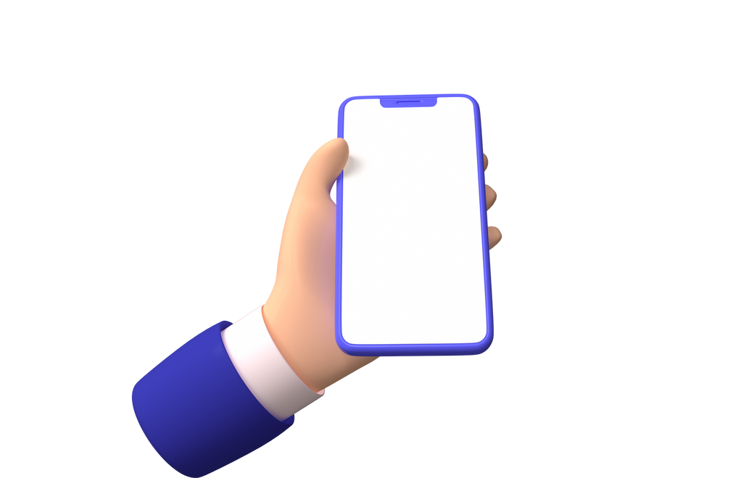

NEEDS
FEATURES
MODULES
Features
Turf Discovery
Real-Time Slot Booking
Notifications & Reminders
Payments & Billing
Turf Owner Dashboard

Slide 9



NEEDS
FEATURES
MODULES
1
User registration/ login(Email, Phone OTP, Google)
Modules
USER
MODULE
2
Profile Management
Booking
3
Notification
payment

Slide 10
NEEDS
FEATURES
MODULES
1
Turf/table registration & verification
Modules
OWNER
MODULE
2
Set available time slots and pricing
3
View upcoming bookings

Slide 11
NEEDS
FEATURES
MODULES
1
User and Turf approval
Modules
ADMIN
MODULE
2
Payment / Report monitoring
3
Content moderation
(Reviews, Support)

Slide 12


TECHNOLOGY
FUTURE-SCOPE
ROLE & RESPONSIBILITY
Technologies
& tools
FRONT-END: HTML, CSS, JS, React.js
BACK-END: NODE.js (Env) + EXPRESS.js
DATABASE: PostgreSQL

Slide 13
FUTURE-SCOPE
TECHNOLOGY
ROLE & RESPONSIBILITY
Technologies
& tools
VS.CODE: for development
GIT for version control
GITHUB for team collaboration
SUPABASE for database

Slide 14

TECHNOLOGY
FUTURE-SCOPE
ROLE & RESPONSIBILITY
Future Scope
1. AI-Powered Smart Recommendations
2. Dynamic Pricing Model
3. In-App Chat & Team Coordination
4. Live Streaming & Match Highlights
5. Hardware Integration for Smart Turfs
6. Training & Coaching Marketplace
7. Nation-Wide Expansion

Slide 15

FUTURE-SCOPE
TECHNOLOGY
ROLE & RESPONSIBILITY
ROLE &
RESPONSIBILITY
Harsh – Frontend Developer
Role: Responsible for designing and implementing the user interface (UI) and user experience (UX) for web/mobile platforms.
Swayam – Backend Developer
Role: Manages the server-side logic, APIs, and system integrations that power the app’s core functionality.
Surbhi – Database administrator
Role: Designs and manages the database schema, structure, and data flows of the application

Slide 16
Database Definition

Slide 17
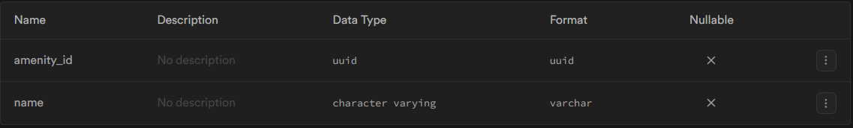
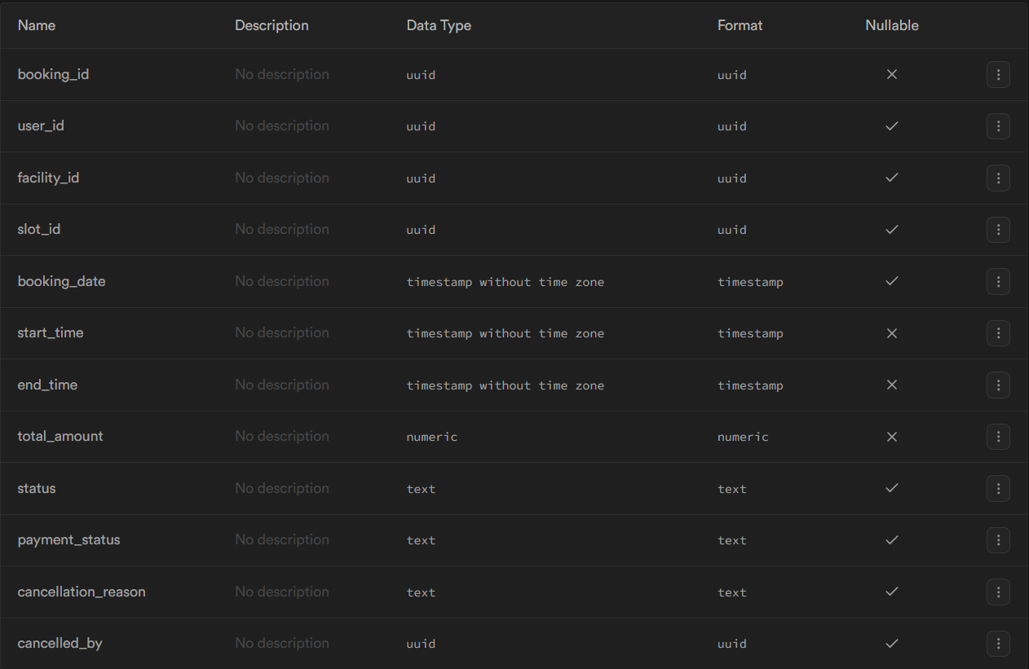
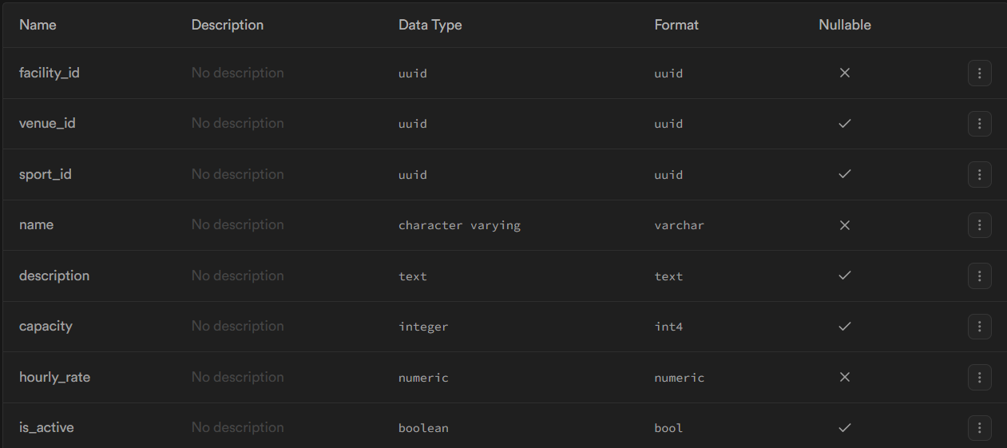
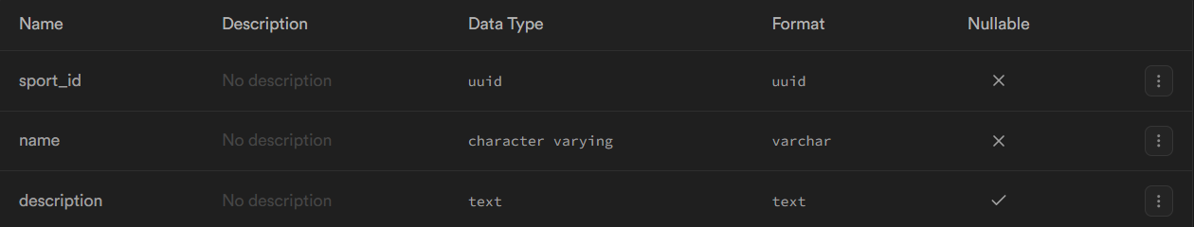
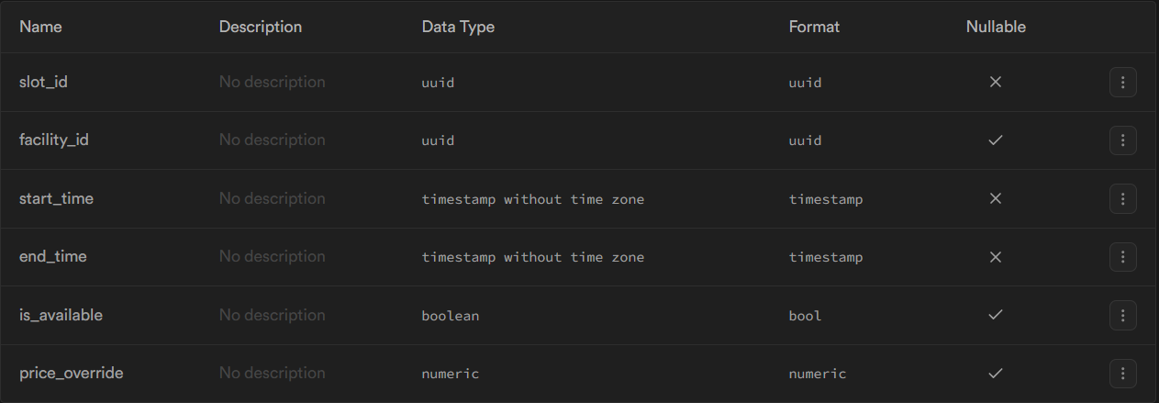
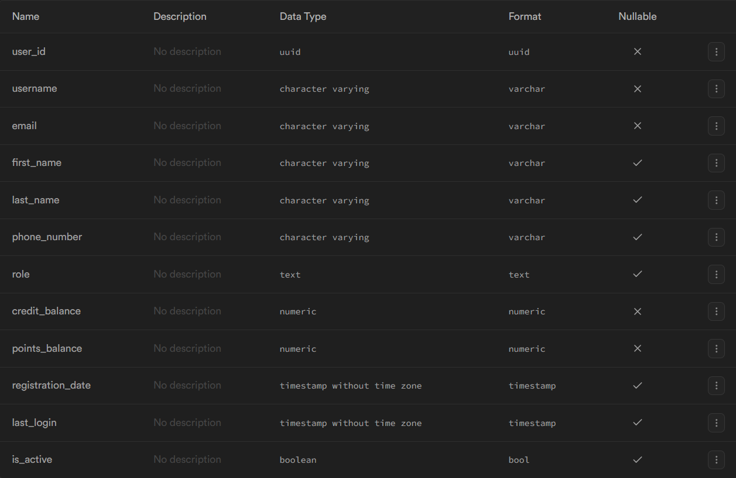
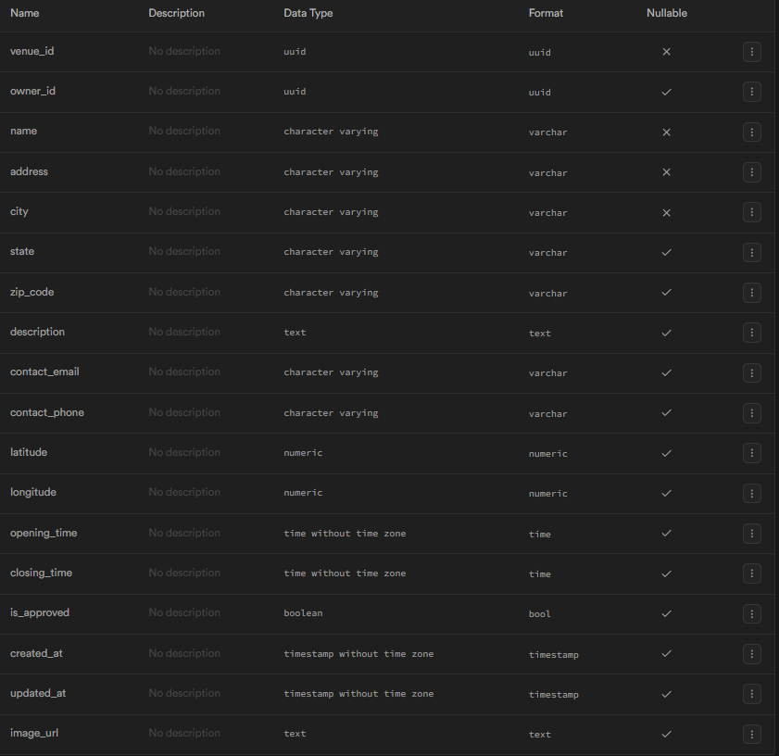
Amenities table
Bookings table
Facilities table
Facilities_Amenities table
Reviews table
Sports table
Time slots table
Users table
Venues table

Slide 18
Amenities table
Bookings table
Facilities table
Facilities_Amenities table
Reviews table
Sports table
Time slots table
Users table
Venues table

Slide 19
Bookings table
Amenities table
Facilities table
Facilities_Amenities table
Reviews table
Sports table
Time slots table
Users table
Venues table

Slide 20
Bookings table
Facilities table
Facilities table
Amenities table
Facilities_Amenities table
Reviews table
Sports table
Time slots table
Users table
Venues table

Slide 21
Bookings table
Facilities table
Facilities table
Facilities_Amenities table
Amenities table
Reviews table
Sports table
Time slots table
Users table
Venues table

Slide 22
Bookings table
Facilities table
Facilities table
Reviews table
Facilities_Amenities table
Amenities table
Sports table
Time slots table
Users table
Venues table

Slide 23
Bookings table
Facilities table
Facilities table
Reviews table
Facilities_Amenities table
Sports table
Amenities table
Time slots table
Users table
Venues table

Slide 24
Bookings table
Facilities table
Facilities table
Reviews table
Facilities_Amenities table
Time slots table
Sports table
Amenities table
Users table
Venues table

Slide 25
Users table
Bookings table
Facilities table
Facilities table
Reviews table
Facilities_Amenities table
Time slots table
Sports table
Amenities table
Venues table

Slide 26

FUTURE-SCOPE
ROLE & RESPONSIBILITY
CONCLUSION
THANK YOU!!

